Slide 1
Russia in the 1990s
Defining a new country

Slide 2
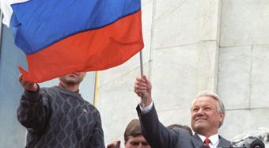
The Putsch of 1991 (Eltsin at the “White House”)

Slide 3
Film after 1991
Strong competition from:
American film;
Video;
Television.
Problems of box-office, financing, audience.
Rise of independent producers.
Role of film in definition of Russia as a new state.

Slide 4
Making the Transition
Many film-makers unable to survive in the new system, e.g. Yury Norshtein, Elem Klimov.
Some survivors: Eldar Ryazanov, Nikita Mikhalkov.
Some new faces emerge: Pavel Lungin (Lounguine), Aleksandr Sokurov, Sergei Bodrov Sr., Andrei Zviagintsev (The Return) , Aleksandr Rogozhkin (The Cuckoo).

Slide 5
New Themes
Socialist Realism has gone completely
New themes:
The Stalinist past and the Terror;
Forgotten Russian heroes and literature;
Religion and symbolic tales;
Organized crime and the “killer”.

Slide 6
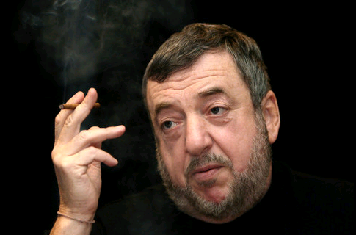
Pavel Lungin (Lounguine, b.1949)
Son of a scriptwriter
Educated first as a linguist, then as a film director
Danelia’s student
Since early 1990s, lives in France, but makes films in Russia
Director, scriptwriter, producer

Slide 7
Selected Filmography
Taxi-Blues (1990) Starring Piotr Mamonov, an underground singer
Luna-Park (1992)
The Line of Life (1996)
The Wedding (2000)
The Oligarch (2002)
The Case of “The Dead Souls” (TV series, 2005)
Poor Relatives (2005)
The Island (2006) Starring Piotr Mamonov
Tsar (about Ivan the Terrible, 2009)

Slide 8
The Wedding (2000)
The action takes place in a small town of coal-miners
Central characters:
Tania, the bride: a top-model coming back to her native town to escape her oligarch lover and to marry her childhood suitor.
Misha, the groom: a young miner, in love with Tania since school. Gives all his money to parents, can’t even buy a wedding present for Tania.
Garkusha, Misha’s never-sober old buddy, brings picaresque elements to the film (picaresque - “satiric prose fiction … depicting in realistic, often humorous detail the adventures of a roguish hero of low social degree living by his or her wits in a corrupt society.”)

Slide 9
The Wedding (2000)
Drama/comedy. Despite the title, not a love-story. Moral conflicts and daily survival of ordinary people.
In the times of disintegrated values, the theme of brotherhood and coming together (younger and older generations; Christians, non-believers and Muslims; working people and oligarchs; police and petty criminals).
Ironic vs serious: inversion of values of Socialist Realism; non-didactic, non-judgmental.
Uncensored: sex and alcohol as subversive elements.
Reality vs “realism”: “unfiltered" take on reality, swearing (rus.мат), hardship, chaos. Hand-held camera: the viewers become “a part” of the crowd.

Slide 10
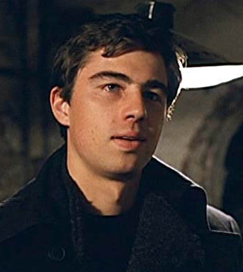
Aleksei Balabanov (1959-)
Brother (1997 Young hitman, newly released from the army, goes to St Petersburg to help his brother.
Brother II (2000). He and his brother go to America.
Danila played by Sergei Bodrov jr. (1971-2002).

Slide 11
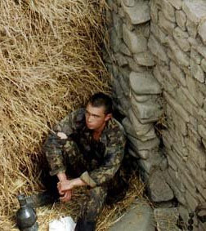
Sergei Bodrov Sr.
Prisoner of the Mountains (1996)
About two Russian soldiers taken prisoner in the Caucasus.
Mongol (2007)

